Slide 1


IoT & IETF
- Rahul Jadhav, Huawei Tech
MSRIT, 22nd Sep’18

Slide 2
Focus for IETF in context to IoT
Emergence of new connectivity protocols for IoT
  802.15.4, TSCH … LoWPAN as it is popularly called
  NB-PLC, NB-Cellular, BLE
Optimize old connectivity
  DECT/ULE, NFC, MSTP

Slide 3

Focus
Emergence of new connectivity protocols for IoT
  802.15.4, TSCH … LoWPAN as it is popularly called
  NB-PLC, NB-Cellular, BLE
Optimize old connectivity
  DECT/ULE, NFC, MSTP
Reducing resource usage
  Control overhead: Since network traffic cost is way too high
  Memory overhead: Since per unit device cost is too low

Slide 4
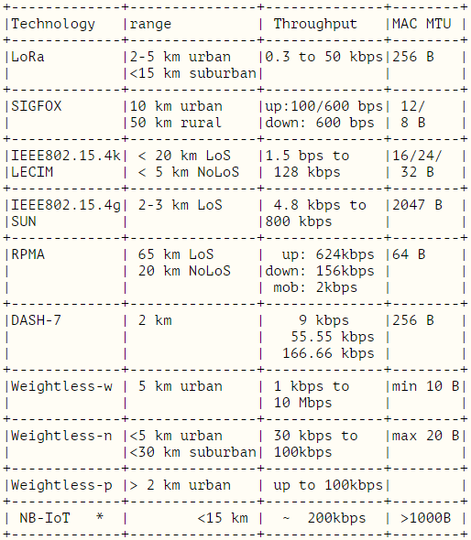
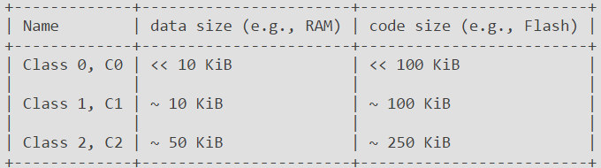
Show me the numbers
RFC 7228: Terminology for Constrained-Node Networks
draft-minaburo-lpwan-gap-analysis

Slide 5
Focus
Emergence of new connectivity protocols for IoT
  802.15.4, TSCH … LoWPAN as it is popularly called
  NB-PLC, NB-Cellular, BLE
Optimize old connectivity
  DECT/ULE, NFC, MSTP
Reducing resource usage
  Control overhead: Since network traffic cost is way too high
  Memory overhead: Since per unit device cost is too low
Supporting Sleepy devices
  Extremely high radio duty-cycling (RDC)

Slide 6

Focus
Security with such constraints
Focus on supporting only IPv6 based connectivity

Slide 7
IETF/IRTF IoT WGs Sandbox
IETF
IRTF
ART
INT
RTG
SEC
---
CORE
CBOR
6LO
6TISCH
LPWAN
IPWAVE
LWIG
ROLL
DETNET
ACE
SUIT
T2TRG
DINRG
ART – Application & Real Time Area
INT – Internet Area
RTG – Routing Area
SEC = Security Area
Notes:
CORE – Constrained RESTful Environments
CBOR - Concise Binary Object Representation Maintenance and Extensions
6LO - IPv6 over Networks of Resource-constrained Nodes
6TISCH - IPv6 over the TSCH mode of IEEE 802.15.4e
IPWAVE - IP Wireless Access in Vehicular Environments
LWIG - Light-Weight Implementation Guidance
ROLL - Routing Over Low power and Lossy networks
DETNET - Deterministic Networking
ACE - Authentication and Authorization for Constrained Environments

Slide 8
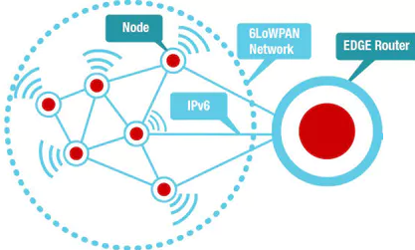
6LO – WG – Problem statement
Problems to deal with
  IPv6 too verbose (40B base header)
  NDP not optimized for IoT
    Multicast not good for IoT
    Existing NDP does not support sleepy devices
  Support multiple link-layer (not only LoWPAN)
  Consider Mesh networks
NDP – Neighbor Discovery Protocol (ARP equivalent of IPv4)

Slide 9
6LO – WG – Key work items
Primary Work
RFC 6282 – 6LoWPAN compression
RFC 6775 – NDP optimization
6lo-over-foo
        RFC 7668 – BTLE compression
        RFC 8105 – Compressed IPv6 for DECT/ULE
        RFC 8163 – Compressed IPv6 for MS/TP
Work in progress
  Address Protection for NDP
  6lo Fragment forwarding without per hop reassembly
  6lo-over-PLC, 6lo-over-NFC
  BLE Mesh
BTLE – Bluetooth Low Energy
NDP – Neighbor Discovery Protocol
PLC – Power Line Communication
NFC – Near Field Communication
MS/TP – Master Slave/Token Passing
DECT/ULE – Digital Enhanced Cordless Telecommunications/Ultra Low Energy

Slide 10
An example… (RFC 6282)
Src port = 0xf0b2
Dst port = 0xf0ba
B
IP pkt
A
IP=fe80::6543
MAC IID=6543
IP=fe80::1234
MAC IID=1234
CID = Context ID
SAC = Source address compression
DAC = Destination address compression

Slide 11
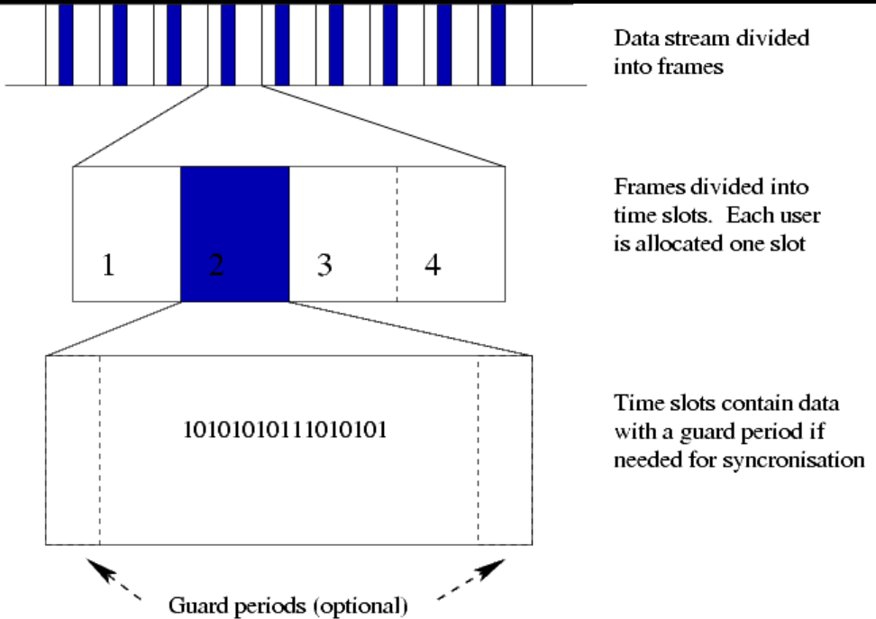
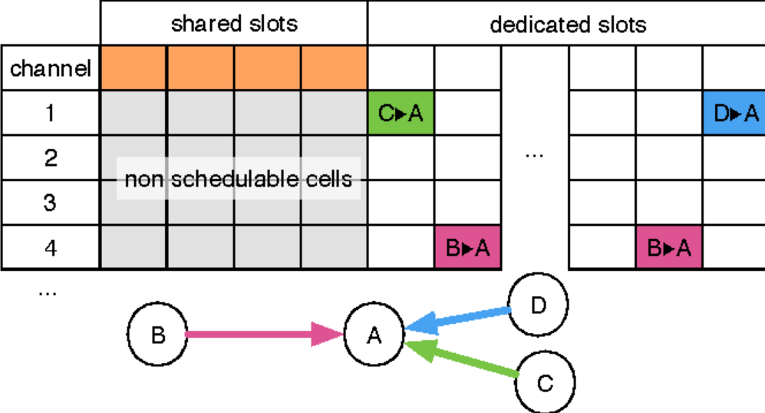
6TISCH - WG
802.15.4e TSCH (Time Slotted Channel Hopping)
    Provides QoS
    Deterministic traffic pattern
Slot scheduling allows
  High RDC
  Gauranteed PDR
PDR – Packet Delivery Rate
RDC – Radio Duty Cycling
QoS – Quality of Service

Slide 12
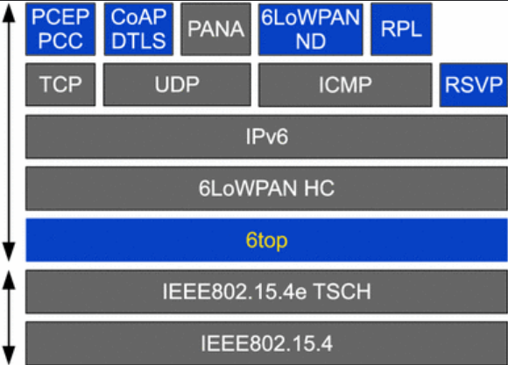
6TISCH – WG – Key work items
RFC 7554 – Using IEEE 802.15.4e TSCH in IoT: Problem Statement
RFC 8180 – Minimal IPv6 over 6TiSCH (routing, scheduling, security)
Work in progress
  6top interface layer
  Minimum scheduling function
    First Dynamic scheduler!

Slide 13
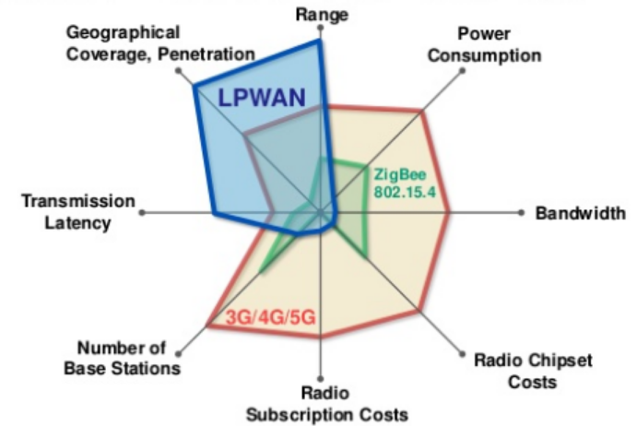

LPWAN - WG
Microbits per second network
Extremely low MTU
Extremely high RDC
Star Networks

Slide 14
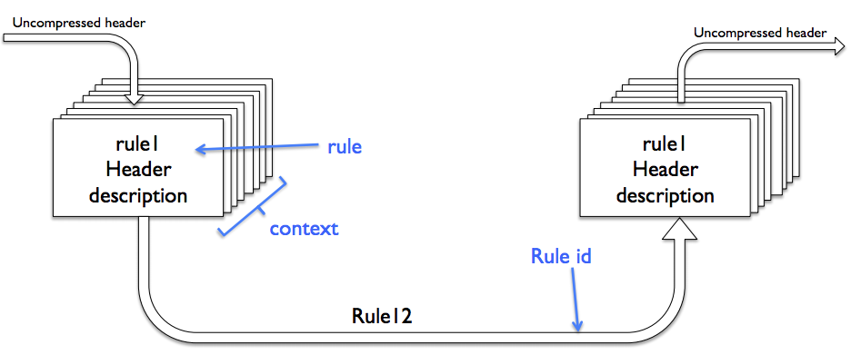
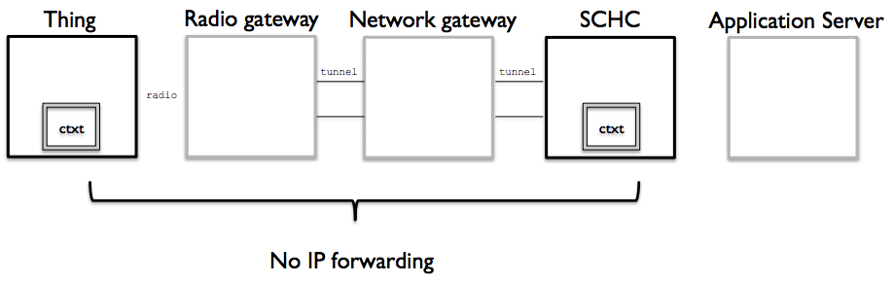
LPWAN – WG – Work items
SCHC Compression
  For Ipv6, UDP, CoAP, ICMP
SCHC-for-foo
  For LoRAWAN, SigFox
Fragmentation/Reassembly
SCHC – Static Context Header Compression

Slide 15
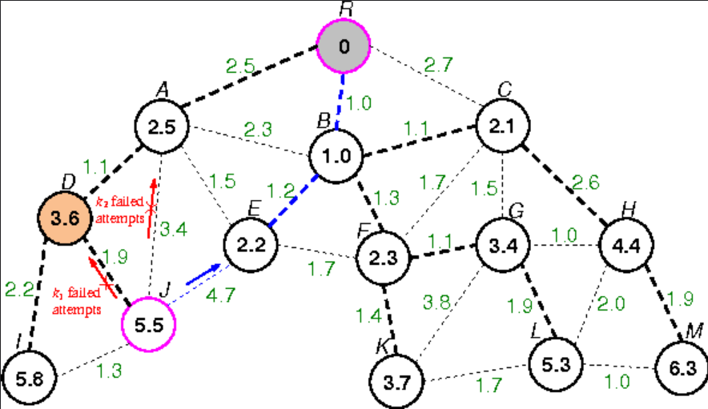
ROLL – WG – Problem Statement
Routing in Low power and Lossy Networks
  Power efficient routing
  Multi-path routing
  Routing for P2MP and MP2P traffic
Efficient route adjacencies decide
  PDR (Packet delivery rate)
  Average Latency
  Route fallback efficiency

Slide 16
ROLL – WG – Work items
RFC 6550 – RPL (Light weight Routing protocol)
RFC 6206 – Trickle Algorithm
RFC 6551/6552 – Routing metrics/Objective Function Zero
RFC 7731 – MPL (Multicast protocol for LLNs)
Current Work in progress
  Optimized route invalidation
  DAO Projection (hybrid routing using SRH and RPI)
  AODV-RPL (Optimized bidirectional P2P paths)

Slide 17
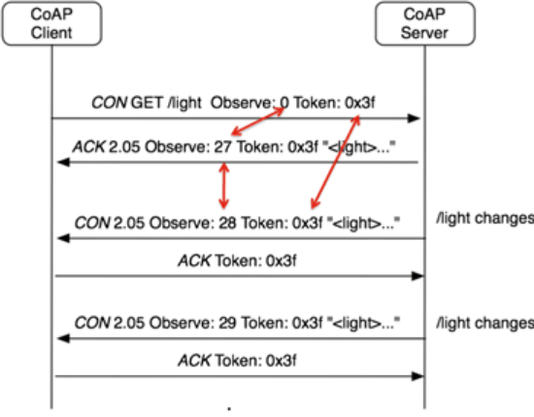
CORE – WG – Problem statement
Application traffic too verbose
Light weight service discovery
Publish-Subscribe model
Light weight data representation model
Management interfaces

Slide 18
CORE – WG – Work items
Light weight RESTful Application protocol
  RFC 7252 (CoAP)
Light weight service discovery
  draft-ietf-core-resource-directory-14 (WIP)
Publish-Subscribe model
  RFC 7641 (Observe-Notify Model for CoAP)
Light weight data representation model
  RFC 8428 (SenML – Sensor Measurement Lists)
Management interfaces
  draft-ietf-core-comi-03 (CoAP mgmt interfaces)
WIP – Work in progress

Slide 19
LWIG – WG – Problem Statements
Provide guidance for light weight implementations
No change in existing signaling or architecture
  All the documents are Informational
Bring your implementation, deployment expertise
LWIG – Light Weight Implementation Guidance

Slide 20
LWIG – WG – Work Items
RFC 7228 (Terminology for Constrained-Node Networks)
RFC 8352 (Energy efficient Features for IoT)
  Ways to do RDC
  Power saving features available in different Rfs
CoAP implementation Guidance (draft-ietf-lwig-coap-06)
TCP usage guidance in IoT
  draft-ietf-lwig-tcp-constrained-node-networks-03
Neighbor Management Policy for 6LoWPAN
  draft-ietf-lwig-nbr-mgmt-policy-02

Slide 21
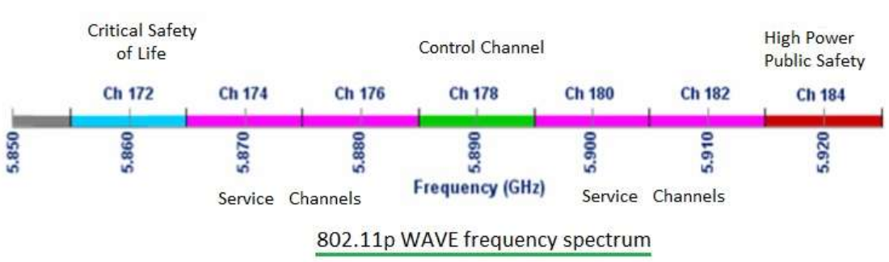
IPWAVE - WG
IPv6 for WAVE/DSRC
  V2V, V2I, V2X scenarios
  Primarily based on 802.11-OCB (previously 802.11p)
Important work item
  draft-ietf-ipwave-ipv6-over-80211ocb
ITS – Intelligent Transportation Systems
WAVE – Wireless Access for Vehicular Environments
OCB – Outside the Context of Basic service set
DSRC – Dedicated Short Range Communications

Slide 22
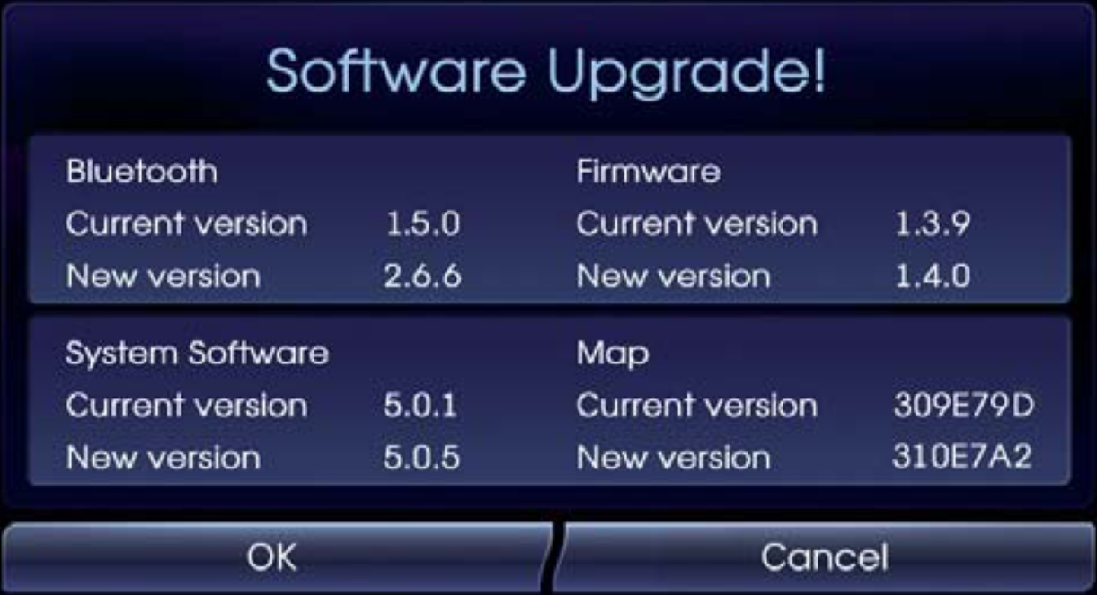
SUIT - WG
Recently formed working group
Handle Secure Update of firmware in IoT
Primary Work items
  Firmware Update Architecture
    Describing entities, security threats, assumptions
  Manifest format for firmware meta-data
  Usable for Class 1 devices
SUIT – Secure Updates for IoT

Slide 23
T2TRG
Research problems in IoT
Problems with no concrete solutions
  Distributed Resource Directory
  Secure IoT Bootstrapping

Slide 24
DINRG
Research problems in Decentralized networks
  Blockchains
  Distributed Web
  Proposals for Blochchain based IoT infrastructure

Slide 25
Standards curry
note: does not contain all ingredients

Slide 26

Talking about standards consolidation
My experience from practical solution building:
- Standards Maturity ?
- Implementation Interop ?
- Stable open source availability ?
- Standards Consolidation ?

Slide 27
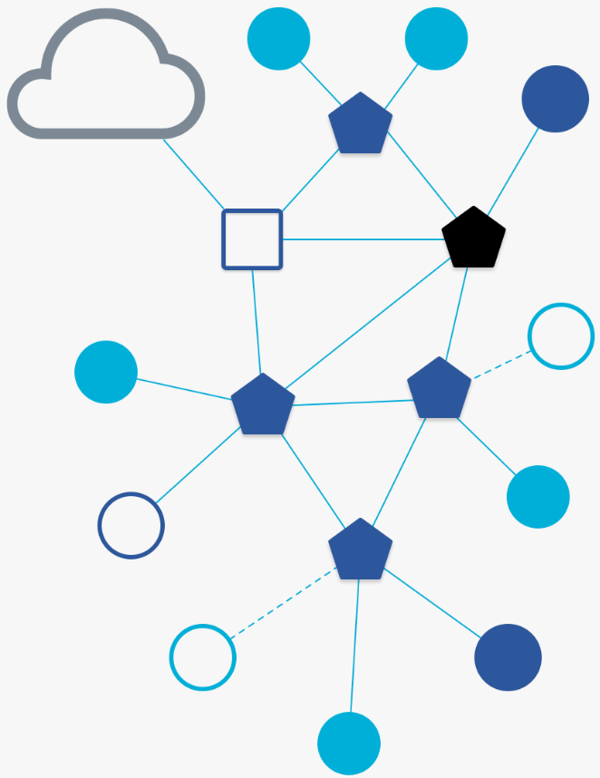

Talking about standards consolidation
Everyone moving towards IP based standard
  Past Decade we had
    Zigbee, Alljoyn/Allseen, ZigbeeIP (ZIP)
    Consolidating towards OpenThread (driven by Google)
  OpenThread mostly relies on IETF standards
    802.15.4 at phy/mac
    6lowpan, IPv6, CoAP/DTLS at above layers
    OpenThread does not use RPL!
Privacy a major issue
  IETF waking up to this reality

Slide 28
Thank You
Questions?
nyrahul@gmail.com
https://github.com/nyrahul

